Slide 1
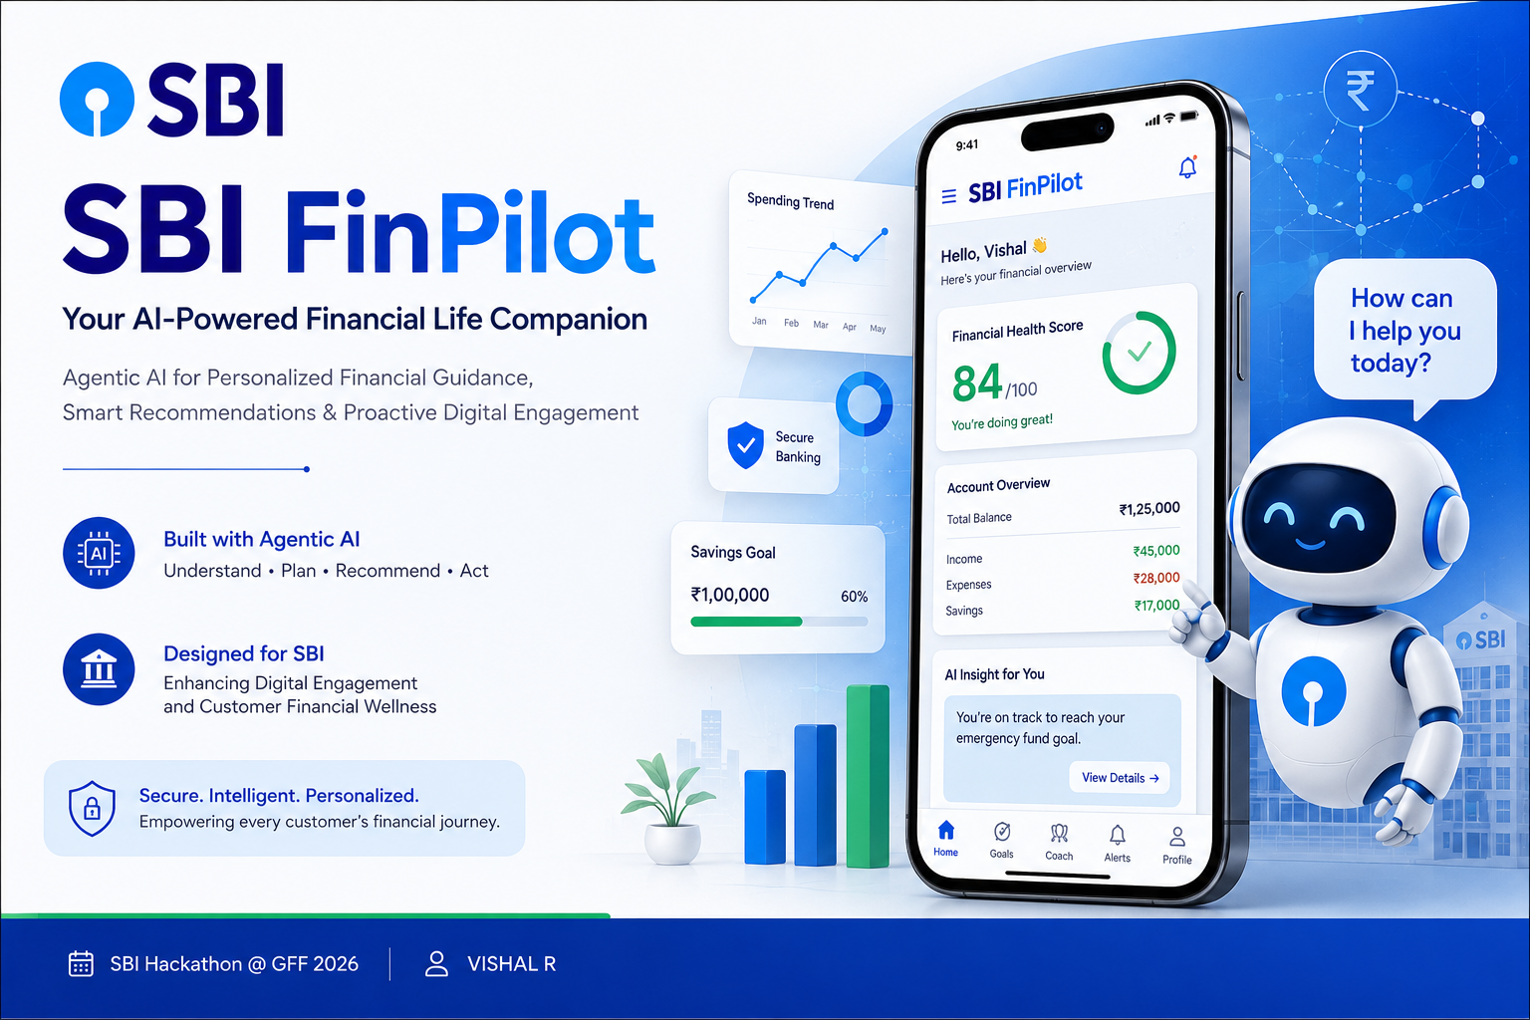
SBI FinPilot
Agentic AI Financial Life Companion
Empowering Every Customer with Intelligent Banking
Theme: Digital Engagement
Presented by
VISHAL R

Slide 2
Problem Statement
Challenges in Today's Digital Banking
Banking apps are mostly reactive
Customers struggle with financial planning
Personalized guidance is limited
Digital banking features are underutilized
Customers miss relevant financial opportunities
.
Current banking experiences are largely reactive.
Customers need proactive, personalized financial assistance.

Slide 3
Our Solution : SBI FinPilot
An Agentic AI-powered financial companion that proactively helps customers manage money, achieve financial goals, and discover the right SBI services at the right time.
Benefits
🤖 AI Coach
📊 Dashboard
🎯 Goal Planner
💡 Recommendations
🔔 Alerts
Customer
│
▼
Financial Data
│
▼
SBI FinPilot (Agentic AI)
│
├── Budget Planning
├── Goal Tracking
├── Smart Recommendations
├── Product Suggestions
└── Smart Alerts
│
▼
Better Financial Decisions
FinPilot transforms banking from reactive to proactive by providing intelligent, personalized financial assistance throughout the customer's journey.

Slide 4
KEY FEATURES
🤖 AI Financial Coach
Personalized financial guidance based on user goals and spending patterns.
📊 Financial Health Dashboard
Tracks income, expenses, savings, and overall financial wellness.
🎯 Goal Planner
Helps users save for education, travel, home, retirement, and emergencies.
💡 Smart Recommendations
Suggests suitable SBI products based on customer needs and life stage.
🔔 Smart Alerts
Sends reminders for bills, EMIs, savings milestones, and unusual spending.
🛡 Fraud Awareness
Detects unusual transaction patterns and provides safety guidance.

Slide 5
How SBI FinPilot Works Agentic AI Workflow
👤 Customer
↓
📱 SBI FinPilot App
↓
🧠 Agentic AI Engine
↓
📊 Financial Analysis
↓
🎯 Decision & Planning
↓
💡 Personalized Recommendations
↓
📈 Continuous Learning
Why Agentic AI?
✔ Understands customer context
✔ Plans financial actions
✔ Acts proactively
✔ Learns continuously
Unlike traditional banking chatbots, SBI FinPilot continuously plans, adapts, and provides proactive financial guidance based on each customer's goals and behavior.

Slide 6
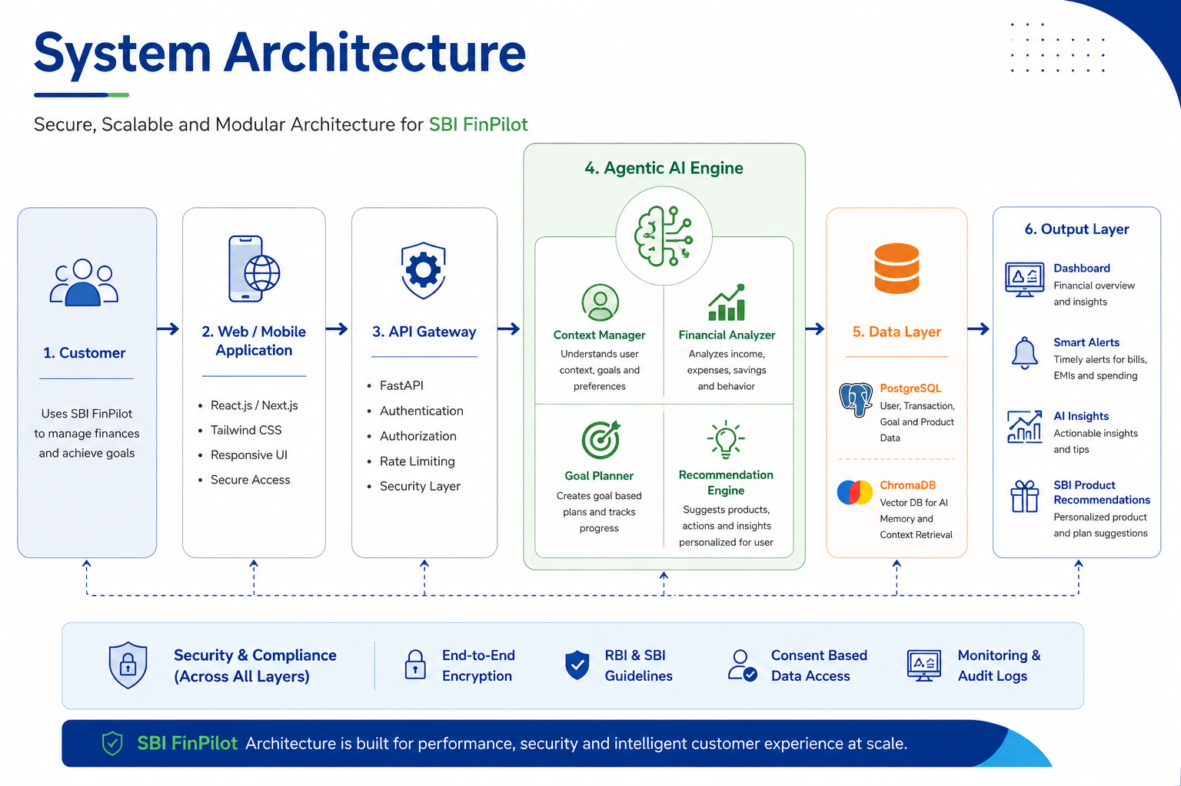
System Architecture
Secure, scalable, and modular architecture designed for seamless integration with SBI’s digital banking ecosystem.

Slide 7
Technology Stack Modern, Secure & Scalable Technology Stack
🖥 Frontend
Responsive and user-friendly interface.
⚙ Backend
Handles business logic and API communication.
🤖 Agentic AI
Financial planning, reasoning, and recommendations.
🗄 Database
Stores user data and AI context.
🔒 Security
Protects customer information.
☁ Deployment
Scalable cloud deployment.
Built using modern AI technologies with enterprise-grade security and cloud scalability.

Slide 8
Implementation Roadmap From Idea to SBI Deployment
Phase 1 Prototype💡
Phase 2 MVP ⚙️
Phase 3 Pilot 🏦
Phase 4 Production 🚀
• UI/UX Design
• AI Chat Assistant
• Financial Dashboard
• Goal Planner
• User Authentication
• Banking API Integration
• AI Recommendations
• Notifications
• Limited SBI Users
• Performance Testing
• Feedback Collection
• Security Validation
• Full SBI Deployment
• Continuous AI Learning
• Product Expansion
• Performance Monitoring

Slide 9
Business Impact Creating Value for SBI and Its Customers
📈 Higher Customer Engagement
Customers interact more frequently with digital banking services.
💰 Increased Product Adoption
Personalized recommendations improve adoption of SBI products.
📊 Data-Driven Insights
Customer behavior insights help SBI improve future services.
📉 Lower Support Costs
AI automates routine financial guidance and reduces
support workload.
🎯 Personalized Financial Guidance
Recommendations based on individual goals and spending.
⏰ Proactive Financial Alerts
Timely reminders for bills, EMIs, savings, and spending.
🛡 Better Financial Awareness
Spending analysis and fraud awareness improve decision-making.
📱 Seamless Digital Experience
A smarter, more engaging banking experience.
SBI FinPilot creates a win-win ecosystem by improving customer financial well-being while driving digital engagement, product adoption, and operational efficiency for SBI.

Slide 10
Competitive Advantage Why SBI FinPilot Stands Out
Feature | Traditional Banking App | Generic AI Chatbot | SBI FinPilot
Personalized Advice | Limited | ⚠️ Basic | Yes
Goal-Based Planning | No | ⚠️ Partial | Yes
Proactive Alerts | No | ⚠️ Limited | Yes
SBI Product Recommendations | No | No | Yes
Continuous Learning | No | ⚠️ Limited | Yes

Slide 11
Future Scope
🌐 Multilingual Support
Serve customers in multiple Indian languages.
🎙 Voice Banking
Voice-enabled financial assistance.
💳 Smart Credit Insights
Help users manage loans and credit responsibly.
📈 Investment Advisor
Personalized investment suggestions based on user goals.
👨‍👩‍👧 Family Financial Planning
Support shared financial goals and household budgeting.
🌍 Open Banking Integration
Connect securely with other financial services where appropriate.

Slide 12
Conclusion
SBI FinPilot transforms digital banking into an intelligent, proactive, and personalized financial experience powered by Agentic AI.

